Slide 1
Project Title: Okoloma Land Fencing
Charter Template
Business Case/ Objectives:
Okoloma integrated oil and Gas plant has 6 export pumps for liquid hydrocarbon evacuation via TNP to Bonny. Reliability of the pumps have dropped recently with 3oo6 currently in operation. The 3 other pumps are due for Overhaul at the vendor yard. This initiative seeks to accelerate the overhaul of those pumps and restore the normal operating model of 6 pumps in OKGP.
Potential Benefits & Measurement:
Restoring Pump reliability and availability
Project Scope/Actions :
Mech seal change-out with a higher capacity rated on P-5101A
Bearing change-out on P-5201A
Major Overhaul on P-5201B and installation on site.
Major overhaul on P-5201C and installation on site.
Major Overhaul on P-5101C and installation on sitePre-mob/ Mob vendor
Critical Success Factors:
Asset Leadership/Stakeholder Support
Project Sponsor: Florence / Ikechukwu
Implementation Team:
Okoloma maintenance team
High-level Timeline:
L0-L1: May 2018
L2: May 2018
L3: June. 2018
L4: Aug. 2018
L5: Sep. 2018
Initiative End (30 Sep. 2018)

Slide 2
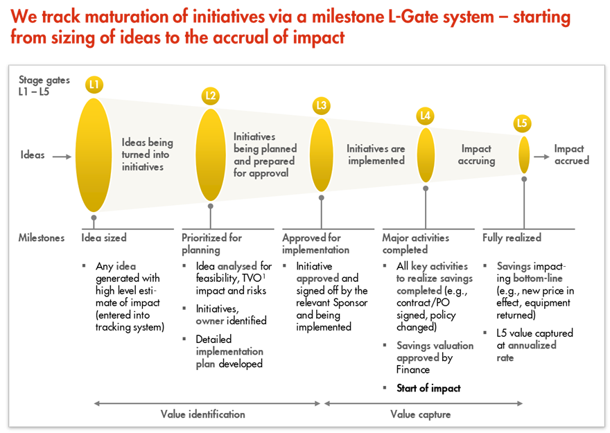
L1 – L5 Gates

